Slide 1
Internal Developer Platform with BackStage.io
Anh Tran

Slide 2
Topic
Introduction
Overview about Backstage
My Solution

Slide 3
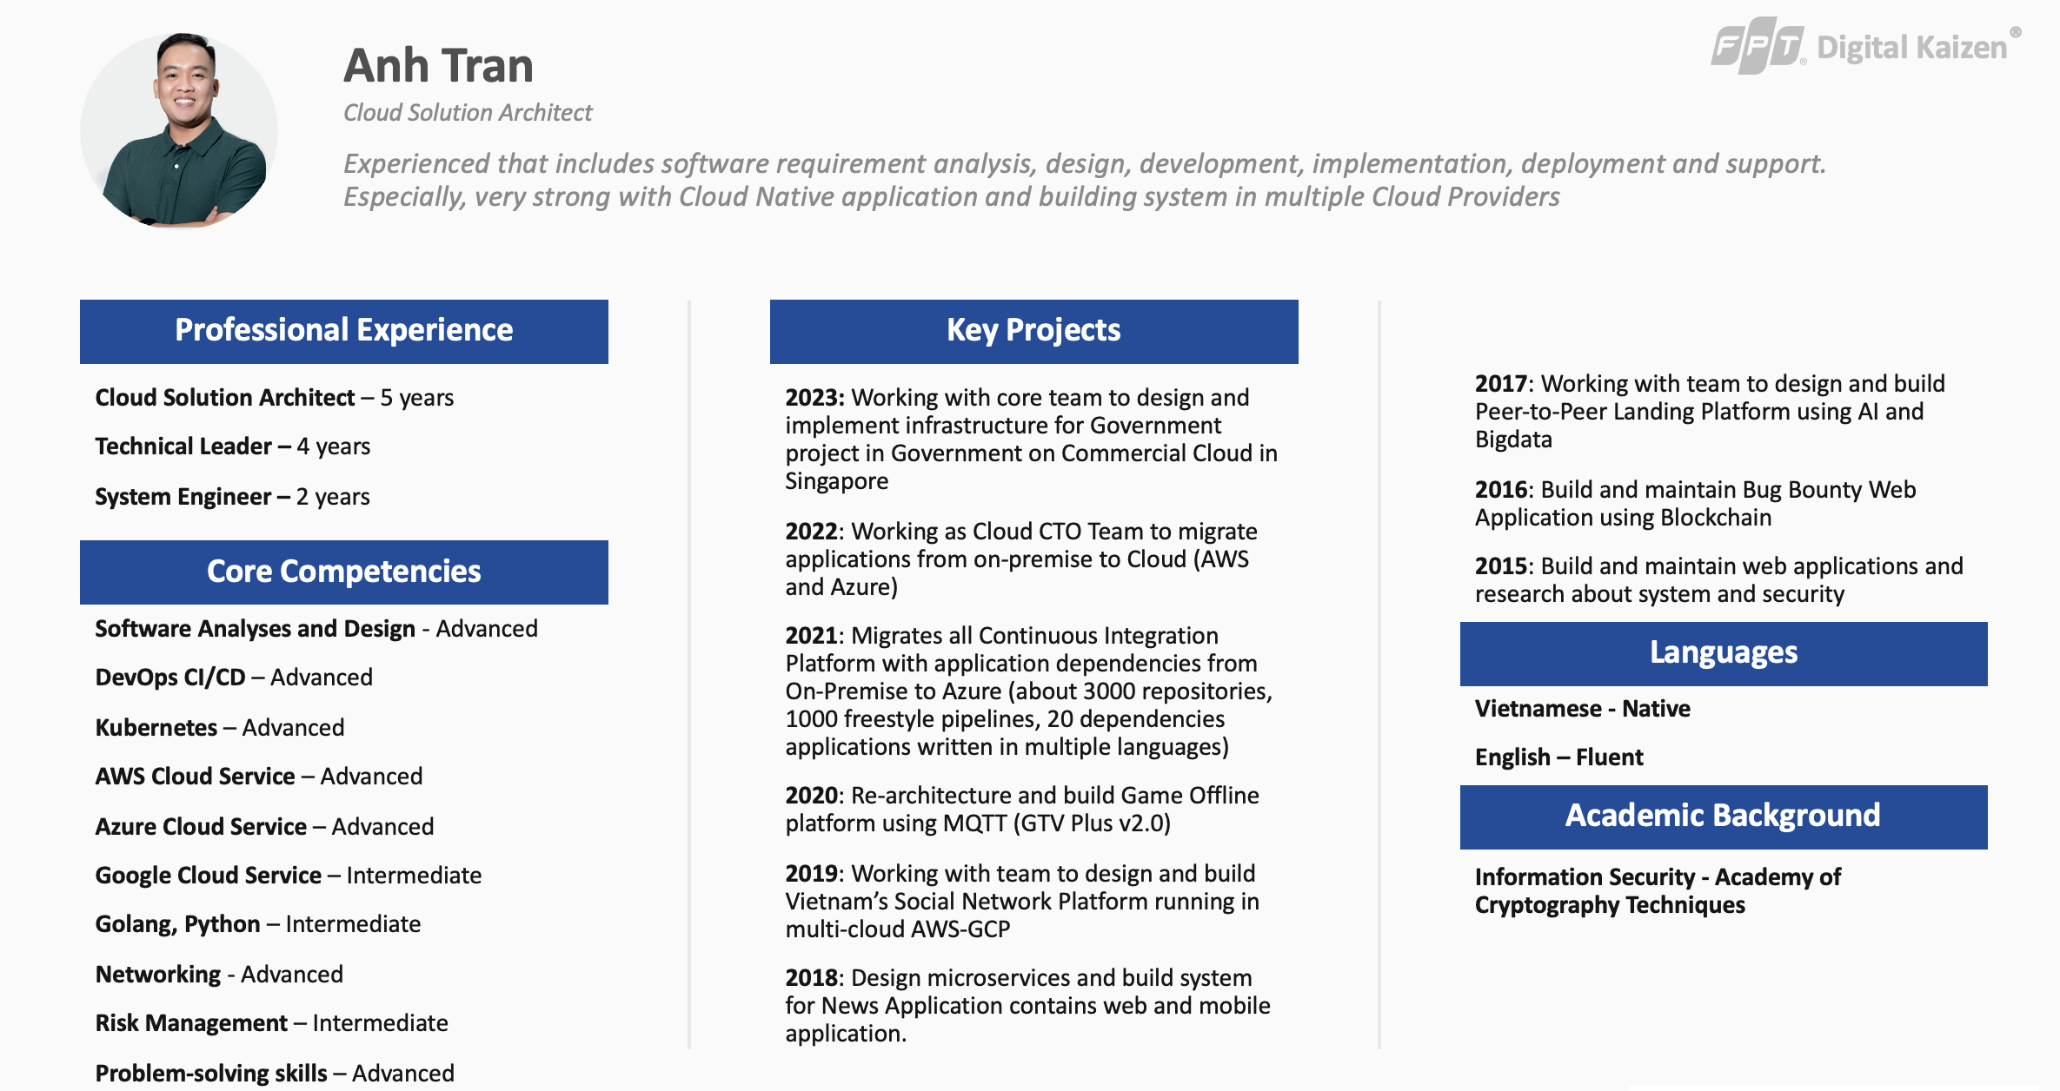

Slide 4
1. Overview

Slide 5
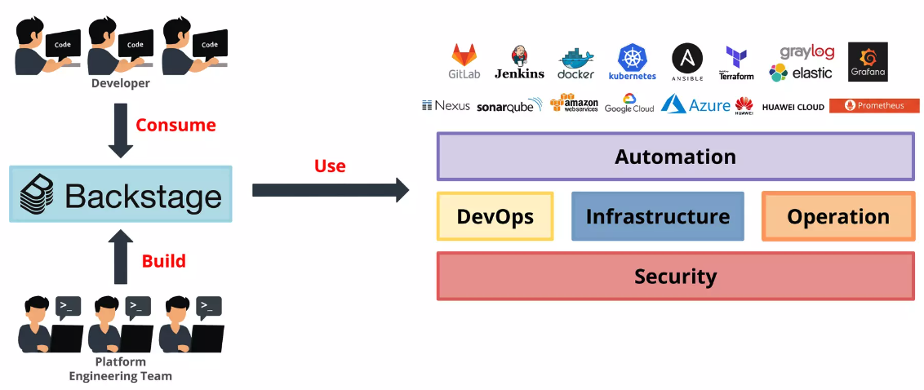
Backstage in my understanding
Internal Developer Portal (IDP) is central hub for tracking, improving, and building high quality software.
IDP abstract away the complexities of ensuring software security, maturity, production readiness and more (all using data from your existing tools.

Slide 6
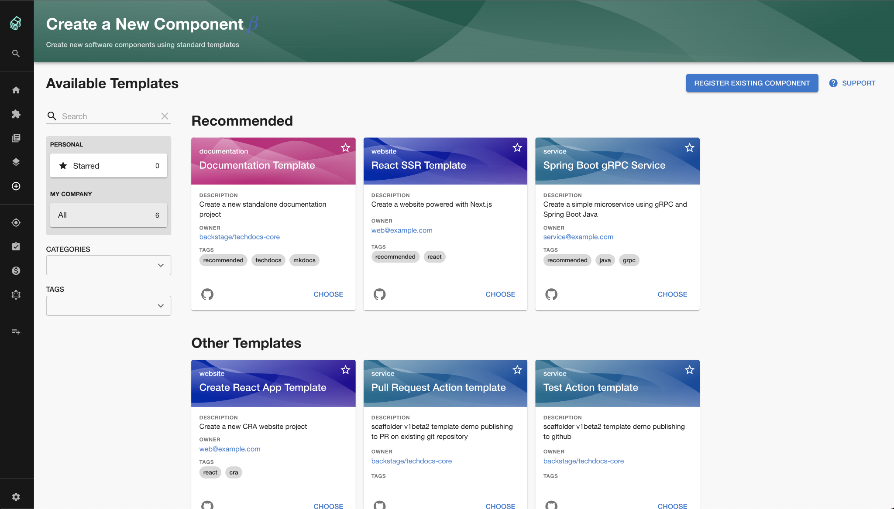
Golden Paths
Golden Path presents a set of best practices organized by typing of engineering project
Provides ‘opinionated and supported’ path to build something

Slide 7
Key Features
Software Catelog
Software Template
TechDocs
Open Source Plugins
Discoverability

Slide 8
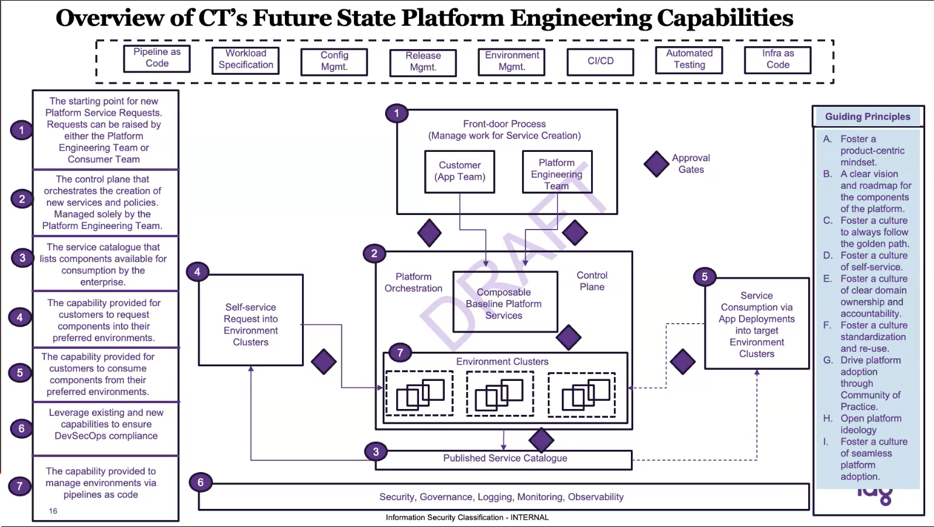
Thinking…

Slide 9
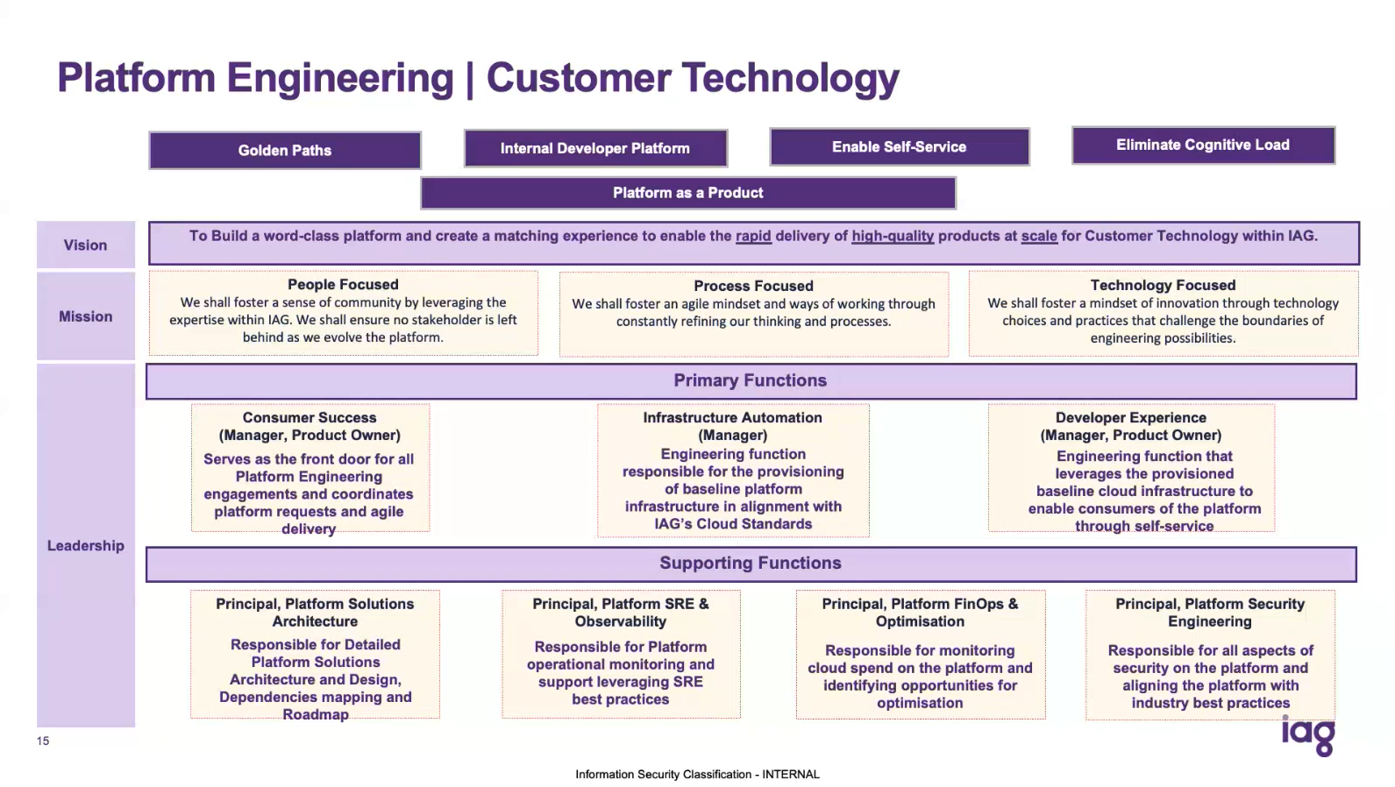
Thinking…

Slide 10













What do we think about?
Developers
Templates with Golden Paths
Microservice

Slide 11

Limitation
Software Catelog?
Software Template?
How do we adapt to current applications?
Authorization?
Secret Integration / Management?
Scalling?
Discoverability?

Slide 12
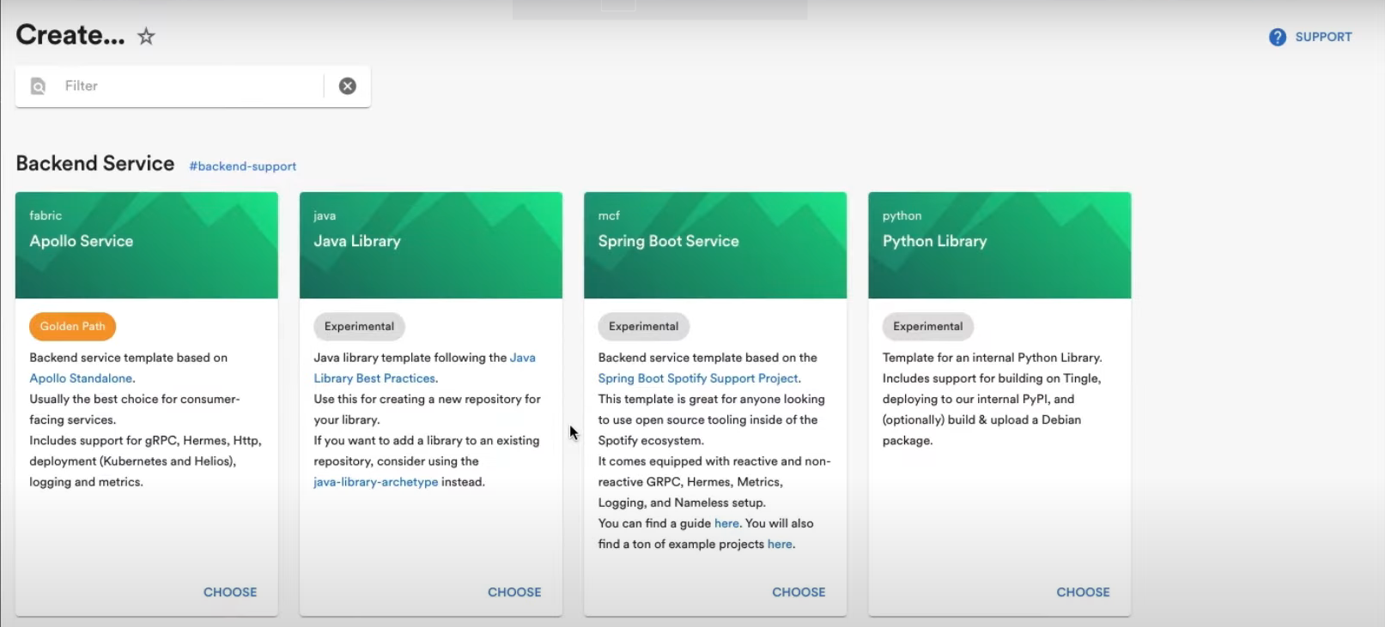
Project / Templates
Template / Catelog
Globalservices
Backend
Appollo Service
Cronjob
Batch job
gRPC
…
Frontend
Static website
Dynamic website
…
CCV2
MuleSoft
Tag
Golden Path
Experimental
Languages (Java, Python, Ansible,...)
Cloud Platform (AWS, GCP, Azure,…)
Toolchains (SecOps, FinOps, …)
…
Types
Sample
Documentation
….

Slide 13
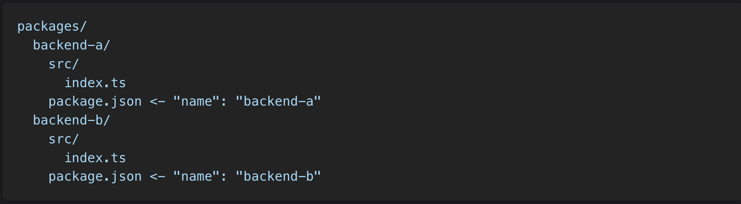
Scaling + Team separated
https://backstage.iag.internal/teamA
https://backstage.iag.internal/teamB
https://backstage.iag.internal
Developers
https://backstage.iag.internal/teamC
Reference: https://backstage.io/docs/backend-system/building-backends/index

Slide 14




Authorization?
Microservice
Environment
Project / Template
Developers
DevOps

Slide 15


Authorization?
Authentication
Developers
Authorized
Template A
Template B
Additional code to Backstage

Slide 16





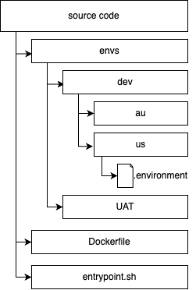

Secret Management
Clusters
deploy
get devops image
.environment
DevOps
container
./devops <env> command
FROM <registry>/devops:master.13
COPY --chown=devops:devops . /home/devops/
.environments
PROJECT="sandbox-devops-104342"
REGION="us-west1"
SECRET="secret/infra/us-west1/"
CLUSTER_PREFIX="dev-au"
CLUSTER_NAME="$CLUSTER_PREFIX-$REGION "

Slide 17
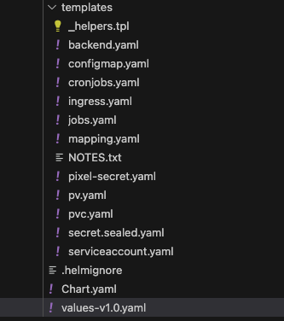

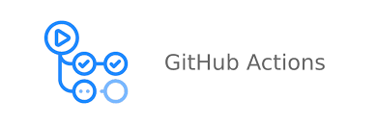


Workflow with Backstage
Templates
- Workloads
- Logging
- Monitoring
- Service Mesh
- Ingress
- …
microservice
env
templates
Developers

Slide 18
Discoverability

Slide 19
Thanks for your listening!

